Slide 1

OBJECT-ORIENTED DESIGN · JAVA
SMART CLEAN
CAMPUS
Smart Campus Cleanliness, Waste Reporting & Management System
CSE 4th Year · University of Rajshahi
Submitted to Dr. Abu Saleh Musa Miah, Professor, Department of CSE
GROUP 04
2210776138 — Md Majnu Miah
2211176104 — Md Masud Rana Mushfiq
2210676120 — Md Emon Khan
“Report. Respond. Resolve. Keep Campus Clean.”

Slide 2
THE OPERATIONAL GAP
02
What Problem Are We Solving?
TRADITIONAL / MANUAL
DIGITAL / TRACEABLE
Delayed waste reporting
Cleaner availability unclear
Wrong or delayed assignment
No completion evidence
Manual task assignment
Limited accountability
Poor report tracking
Nearest cleaner may be unavailable
How can a reported cleanliness problem reach the nearest available cleaner and be tracked until verified resolution?

Slide 3
CENTRALIZED WEB PLATFORM
03
Smart Clean Campus
One connected workflow turns a campus observation into a verified, auditable resolution.
Campus User
Report
Location
Nearest Cleaner
Notify
Clean
Evidence
Verify
Closed
Faster response
Location-aware assignment
Automatic notification
Evidence-based verification
Transparent tracking

Slide 4
CLEAR OWNERSHIP
04
Role-Based System
01
02
03
04
Campus User
Cleaner
Supervisor
Administrator
Report issues · Track status
Receive tasks · Update status · Upload evidence
Verify cleaning · Approve or reopen
Manage users · Oversee operations

Slide 5
STRUCTURED DIGITAL INTAKE
05
Report a Cleanliness Problem
PROBLEM CATEGORIES
Problem category
Overflowing bin
Scattered waste
Plastic / food waste
Illegal dumping
Dirty classroom / corridor
Drain blockage
Event-related waste
Description
Location
Date & time
Photo upload
GPS / location data
REPORT ID SCC-20260815-00452

Slide 6
RULE-BASED ASSIGNMENT
06
Nearest Available Cleaner
New Report → Locate → Find Nearby → Check Availability → Exclude Busy → Select Nearest → Create Task
A · 100m
UNAVAILABLE
REPORT
DECISION PARAMETERS
Location
Availability
Current status
Workload
B · 250m
ASSIGNED

Slide 7
STATUS-AWARE EXCLUSION
07
Cleaner Availability Management
AVAILABLE
vs
BUSY / UNAVAILABLE
LEAVE / APPLICATION DOCUMENT
Unavailable cleaners must enter a reason, provide leave/application information, and upload supporting documentation. They are automatically excluded from new tasks.
Upload supporting document photo
JPG, PNG or PDF
A = 100m · unavailable → EXCLUDED
B = 250m · available → ASSIGNED
CHOOSE FILE

Slide 8
NO MANUAL SEARCH REQUIRED
08
Automatic Waste Notification
Waste Report
Nearest Available
Cleaner
Task Created
In-App + Email
NEW CLEANING TASK
Overflowing Waste Bin
CSE Building — 2nd Floor
Priority: HIGH
SCC-20260815-00452

Slide 9
CONTROLLED TASK LIFECYCLE
09
From Report to Resolution
REPORTED
ASSIGNED
NOTIFIED
ACCEPTED
IN PROGRESS
COMPLETED
REVIEW
CLOSED
REOPENED → REASSIGNED
Every transition is explicit, permission-controlled, and recorded.

Slide 10
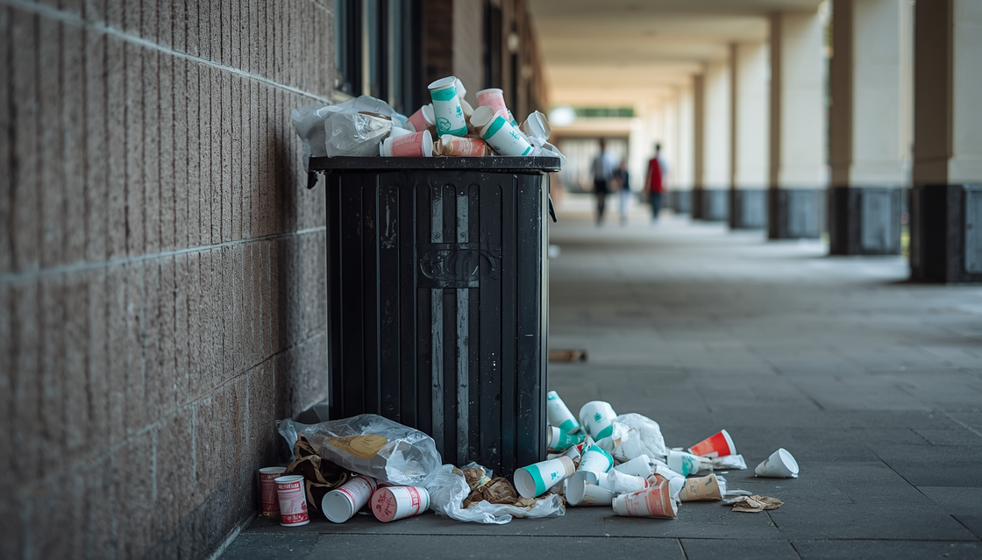
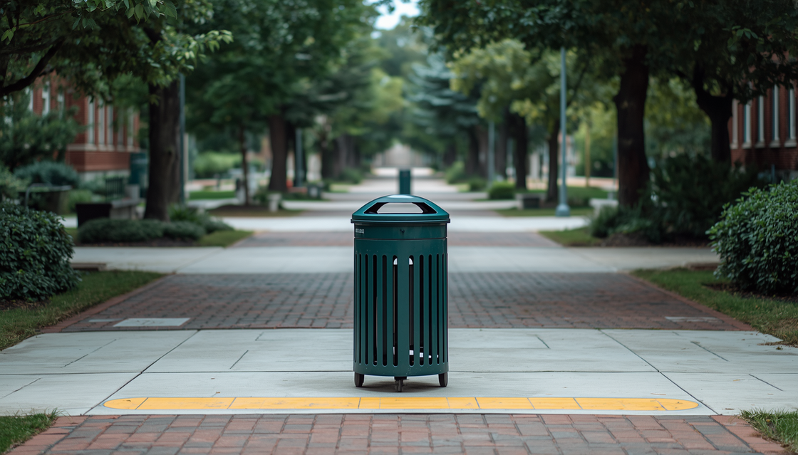
BEFORE → AFTER → DECISION
10
Evidence-Based Cleaning Verification
BEFORE · USER EVIDENCE
AFTER · CLEANER EVIDENCE
Submit photo → Clean → Upload after photo → Supervisor review → Approve / Reopen

Slide 11
TRANSPARENT AUDIT TRAIL
11
Complete Report Tracking
Reported
Assigned
Accepted
In Progress
Completed
Verified
Closed
ACTOR ACTION TIME STATUS
Campus User Report submitted 09:14 REPORTED
System Cleaner B assigned 09:15 ASSIGNED
Supervisor Evidence approved 10:02 CLOSED

Slide 12
THE RIGHT VIEW FOR EVERY ROLE
12
Role-Based Dashboards
CAMPUS USER
CLEANER
SUPERVISOR
ADMINISTRATOR
My Reports
Status
Notifications
New Tasks
Active Tasks
Availability · Workload
Pending Tasks
Verification
Cleaner Status
Total Reports
Completed / Pending
Basic Statistics
12
04
07
86%

Slide 13
MODULAR MONOLITH
13
Object-Oriented Modular Architecture
WEB CLIENT
REST API
SPRING BOOT
POSTGRESQL
Authentication
User Mgmt
Report Mgmt
Location
Assignment
Task
Notification
Verification
Dashboard
WebSocket → In-App Notification
Email Service → Cleaner / Supervisor

Slide 14
BUILT FOR MAINTAINABILITY
14
Technology Stack & Object-Oriented Design
TECHNOLOGY
OOD CONCEPTS
CORE DOMAIN OBJECTS
Java · Spring Boot
REST API · PostgreSQL
JPA / Hibernate
WebSocket · Spring Security
Email Notification
JUnit / Mockito
Git / GitHub
Encapsulation
Abstraction
Inheritance
Polymorphism
Composition / Association
User · CampusUser
Cleaner · Supervisor
Administrator · Location
WasteReport · CleaningTask
CleanerAvailability
Notification · PhotoEvidence
Verification · AuditLog

Slide 15
SMART CLEAN CAMPUS · GROUP 04
From Report to
Verified Resolution
REPORT → LOCATE → ASSIGN → NOTIFY → CLEAN → EVIDENCE → VERIFY → CLOSE → TRACK
Digital reporting · Nearest-available assignment · Availability management
Automatic notifications · Controlled lifecycle · Before/after verification
Transparent audit trail · Role-based dashboards
THANK YOU
QUESTIONS & DISCUSSION
“Every step is connected, transparent, and accountable.”

